Slide 1
ECOWREX
ECOWAS OBSERVATORY FOR RENEWABLE ENERGY AND ENERGY EFFICIENCY Prospective development of the ECOWAS Observatory for RE&EE Accra, Ghana 29 October‏ 2012

Slide 2
PRESENTATION OUTLINE
ECOWREX System
Current sections: Country Profile, Map Viewer, Analysis & Trends and Explore
New sections
New functionalities
New targets
Partners

Slide 3
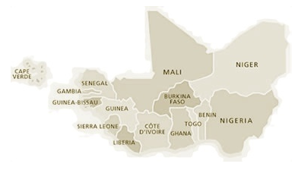
Systemic improvement: interactive involvement
Version 2012
ECREEE collects data and process
ECOWAS countries are data generators
International community is data provider
Version 2013
ECREEE validates data and provides analysis
ECOWAS countries are active users and data providers
International community is user

Slide 4
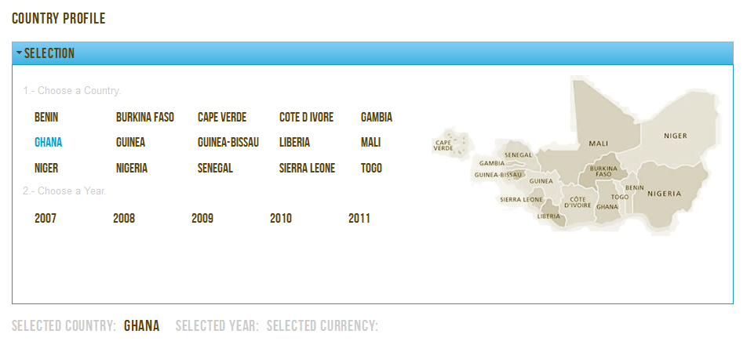
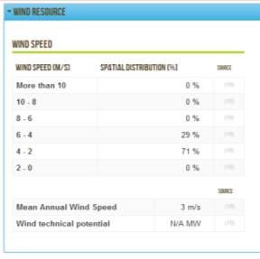
Current section: Country Profile
Obtaining more historical data from ECOWAS countries to complete yearly datasets
Improvement of current indicators and sections
Inclusion of an ECOWAS Regional section
Addition of new indicators (feedback!)
Elaboration of Country Report (Full and specific reports)

Slide 5
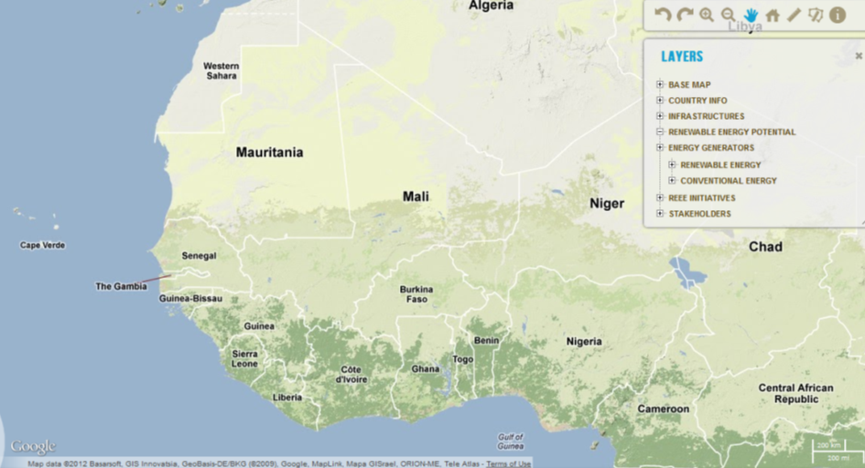
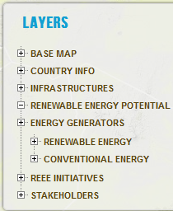
Current section: Map Viewer
Improved accuracy of RE Resource Assessment
Elaboration of RE Electricity Potential Maps
Elaboration of Electricity demand map
Inclusion of other relevant country maps

Slide 6
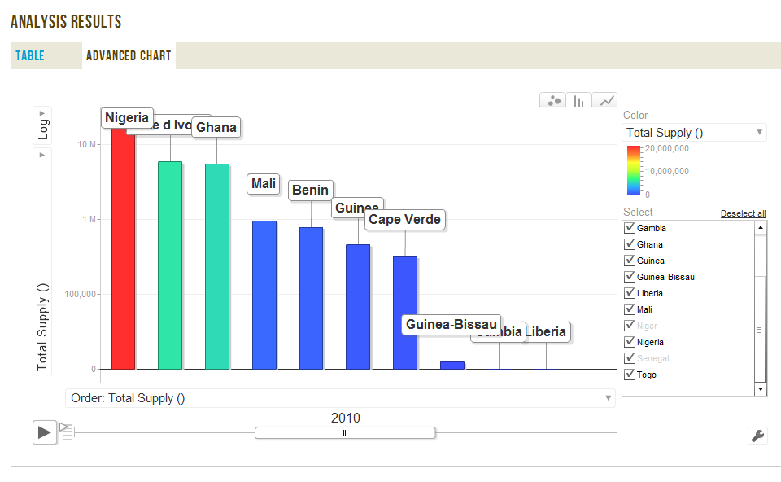
Current section: Analysis & Trends
Improved advanced analysis indicators and tools
Elaboration of pre-defined charts and graphics
RE ECOWAS Status Report
Publication of detailed analysis about certain indicators and trends

Slide 7
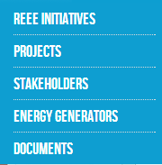
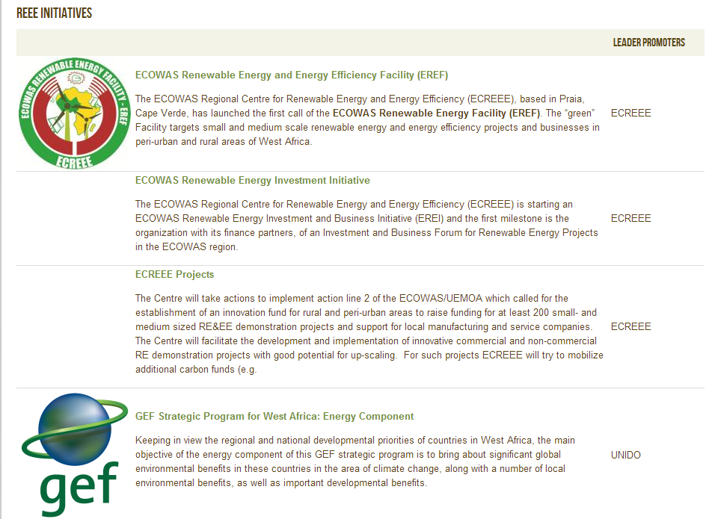
Current section: Explore
Inclusion of new RE&EE ECOWAS initiatives upon request
Improvement of stakeholders and contacts database
Upgrade of relevant and up-to-date RE&EE documents in the library

Slide 8
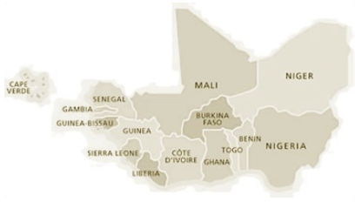
New sections: RE&EE Business and Investment Square
RE&EE Investors
RE&EE Suppliers
Linking all relevant stakeholders in RE&EE infrastructures
Increasing attractiveness of financing framework in RE&EE investment in ECOWAS countries (project appraisal, enabling environment)
RE&EE Promoters
RE&EE Installers

Slide 9
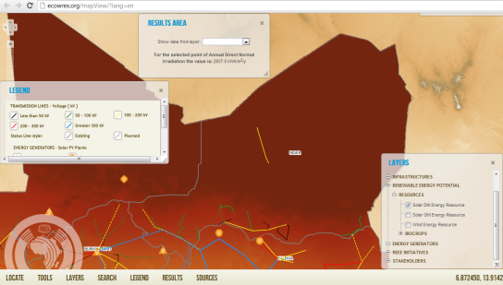
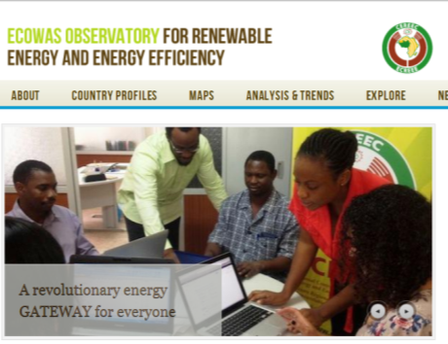
New sections: Planning Tool
Using data from ECOWREX (in datasets and maps)
Using available software and tools
Applying estimations and assumptions for simplification
TOOL PERMITING TO OBTAIN A PRELIMINARY FEASIBILITY APPRAISAL OF RE PROJECTS

Slide 10
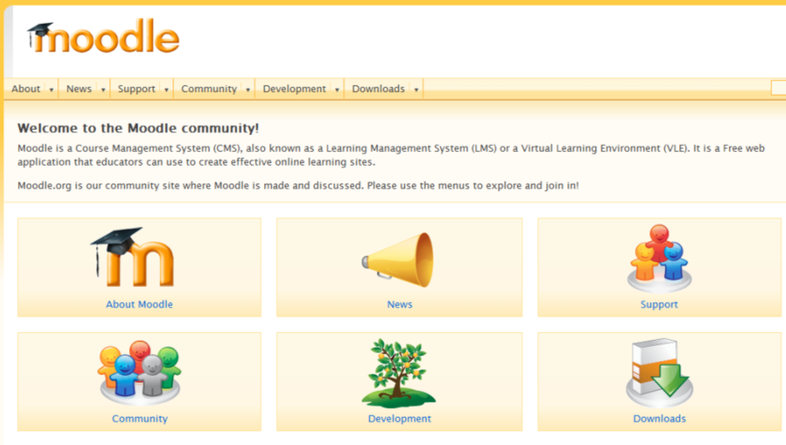
New sections: E-learning Platform
Advocating and sharing relevant RE&EE training activities for ECOWAS countries
Organizing specific short courses and webinars on RE&EE
Compiling RE&EE learning materials for the ECOWAS community
Providing certification for users in different RE&EE subjects
Using ECOWREX data to improve ECOWAS knowledge on RE&EE

Slide 11
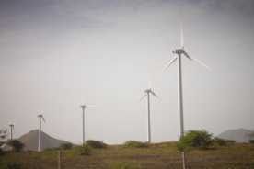
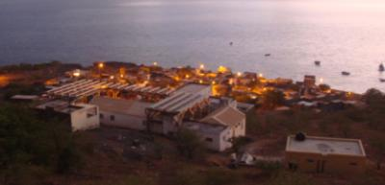
New target
Current target
Grid connected RE infrastructures
National macroeconomic indicators
National Electricity Planning
ECOWAS Countries
Supply side analysis driven
New target
Off-grid and isolated systems
Rural electrification policies, context and trends
Sub-national competences and indicators
All Africa: understanding the African context to compare ECOWAS countries
Demand side analysis driven

Slide 12
ECOWREX Partners
Country Profile
Map Viewer
Analysis & Trends
Explore
ECOWAS Ministries of Energy
ECOWAS Ministries of Energy
Business Square
Planning Tool
E-learning Platform
Open Linked Data

Slide 13
Thank you!
Merci!
Muito Obrigado!
Visit our website www.ecowrex.org and give us your feedback
With the core collaboration and support of:

